Slide 1
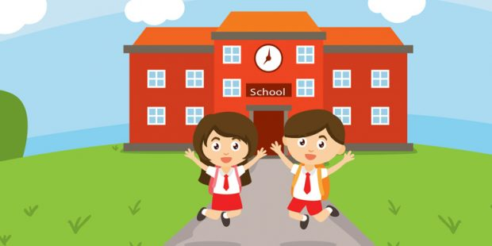


START

Slide 2

What can you see?

Slide 3
MOUNTAINS
?
CAN YOU GIVE ANOTHER EXAMPLE?
We are learning about mountains, animals and oceans.

Slide 4

What can you see?

Slide 5
PLANTS
?
CAN YOU GIVE ANOTHER EXAMPLE?
We get to look at all of the different plants.

Slide 6
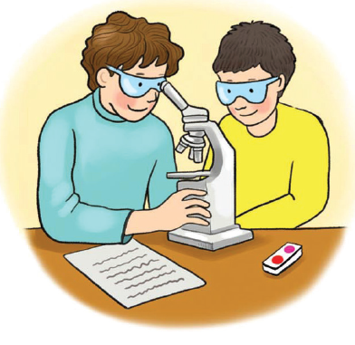
What can you see?

Slide 7
SCIENCE
?
CAN YOU GIVE ANOTHER EXAMPLE?
My favorite class is science.

Slide 8
UNIT 1
LESSON 1
WHAT GRADE ARE YOU IN?

Slide 9
This lesson will learn about :
1. School subjects and grades (years in school),
2. Giving and asking for information about school subjects and grades, and
3. Giving detail Clarifications about favorite school subjects.

Slide 10

LET’S PRACTICE

Slide 11
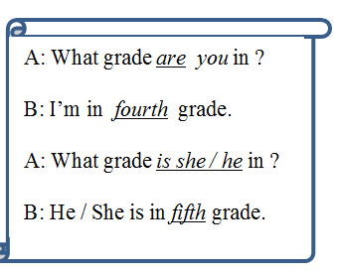
SENTENCE PATTERN
A: What is [your / his / her] favourite subject ?
B: My / His / Her favourite subject is

Slide 12
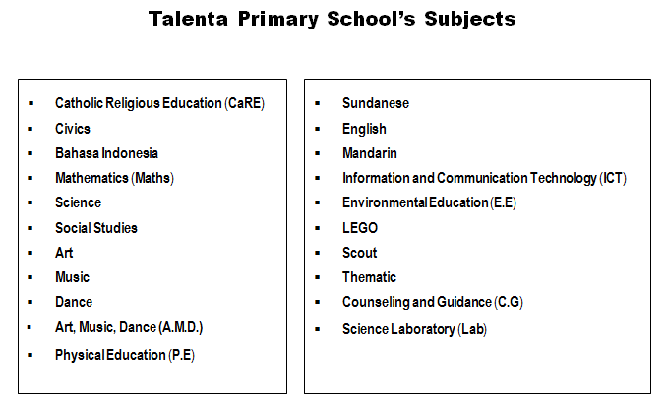

Slide 13
QUIZ

Slide 14
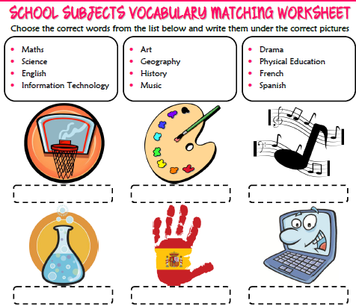

Slide 15
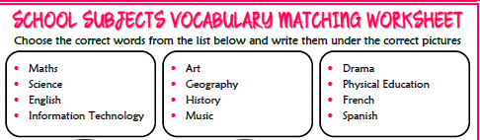


Slide 16
THANK YOU
SEE YOU NEXT TIME

