Slide 1
Unit 1 Lesson 2
Do You Like
Ice Cream?

Slide 2
LESSON OBJECTIVE
Student can identify and mention the name of food.
Students can express likes and dislikes.

Slide 3
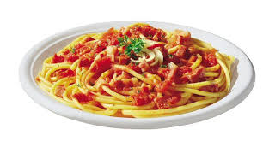
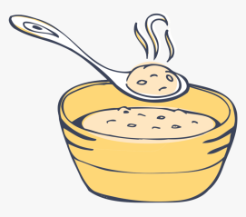
VOCABULARIES
Ice cream
Cake
Fish
Spaghetti
Porridge

Slide 4
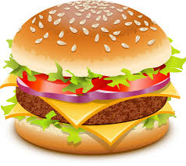
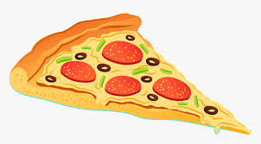
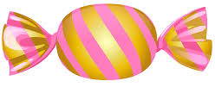
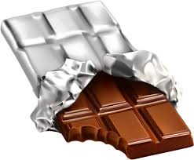
VOCABULARIES
Burger
Cup cake
Pizza
Candy
Chocolate

Slide 5
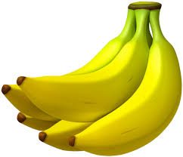
VOCABULARIES
Apple
Bananas
Mango
Orange
Watermelon

Slide 6
CONVERSATION
A : Do you like pizza?
B : Yes, I do.
No, I don’t.
I like pizza.
I don’t like pizza.

Slide 7
CONVERSATION
A : Do they like bananas?
B : Yes, they do.
No, they don’t.
They like bananas.
They don’t like bananas.

Slide 8
CONVERSATION
A : Does she like spaghetti?
B : Yes, she does.
No, she doesn’t.
She likes spaghetti.
She doesn’t like spaghetti.

Slide 9
CONVERSATION
A : Does he like noodles?
B : Yes, he does.
No, he doesn’t .
He likes noodles.
He doesn’t like noodles.

Slide 10
They go swimming.
They go hiking.
They go fishing.

Slide 11
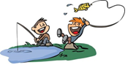
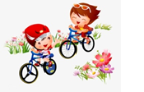
What do they like?
They like fishing.
What do they like?
They like cycling.

Slide 12
Lets sing a song

Slide 13
