Slide 1
DESCRIPTIVE TEXT

Slide 2
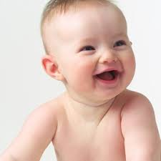

Slide 3
WHAT IS HE LIKE?

Slide 4
HE IS ....

Slide 5
HE IS (CUTE)

Slide 6
HE IS (CUTE)

Slide 7
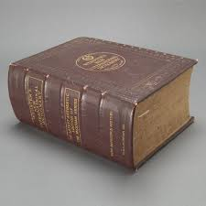

Slide 9
DO YOU SEE MY DICTIONARY?
WHAT DOES IT LOOK LIKE?

Slide 10
IT IS ...

Slide 11
IT IS (THICK)

Slide 12
THE COLOUR IS ...

Slide 13
THE COLOUR IS (BROWN)

Slide 14
I KNOW WHERE IT IS .

Slide 15
IT IS ...

Slide 16
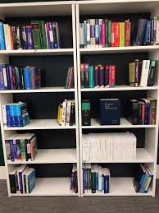

Slide 17
IT IS (ON THE BOOK RACK)

Slide 18
OH THANK YOU

Slide 19
I COULD’T FIND YOUR HOUSE. CAN YOU TELL ME WHERE IT IS?

Slide 20
IT IS ...

Slide 22
IT IS IN HOUSING COMPLEX, SO EVERY HOUSES LOOK THE SAME. BUT THE COLOUR OF MY HOUSE IS GREEN.

Slide 23
Now we are going to learn descriptive text!

Slide 24
EXAMPLE OF DESCRIPTIVE TEXT
My Sphynx cat is the only pet I have. He has a little hair but is not totally hairless as he has a peach fuzz over much of his body. His coat is often a warm chamois. My Sphynx has a normal cat proportion.
I like his tail although my mom say that it is like a rats tail. I love his usual color varieties including, tortoiseshell, chocolate, black, blue, lilac, chocolate etc. He is really an amazing cat. Believe it or not, he is very intelligent cat. He can respond my voice commands. He is really funny as well as my friends get a joke. I love him so much as I love my mother.

Slide 25
EXAMPLE OF DESCRIPTIVE TEXT
I live in a small house. It has five rooms: there are two bedrooms, a living room, a bathroom, and a kitchen. Indeed it is a small house; but I like living in here for wasting my spare time.
When the door is open, I can see the living room. It is so small with only three chairs and a table, nothing else. I prefer reading a novel in this room.
My bedroom is in the left side of the living room. In this room there is a night table next to the bed, a TV, a radio, and a computer. When being bored of reading, I usually play online games, chat with my friends via Facebook and so on.
Next to my bedroom is my mother’s. I do not know what is inside because I never come in to see it. In the right side of the living room there is the kitchen. In the kitchen I have everything I need when I get hungry. It is very pleasure when my mother cooks, the smell fills my whole house.
I know it is a very small house; but it is the best place I have ever seen.

Slide 26
EXAMPLE OF DESCRIPTIVE TEXT

Slide 27
EXAMPLE OF DESCRIPTIVE TEXT
My Friend, Dinda
A pretty girl who is sitting on the chair is Devya Dinda. People call her Dinda. She has a long black hair that is always neatly tied up. The pony in front of her head covers her forehead. She has a white skin and two beautiful black round eyes with flicks eyebrow. Her noose is not too sharp but also not too flat. Her round face and chubby cheeks make people want to touch it. She has a sweet little red lip coupled with some soft hairs above look like a mustache which add her sweetness as a girl.
Dinda‘s body is little bit fat. She is not too high which only around 164 cm. However, she is very energetic and active girl. She also always notices her style in dressing. She always dress attractively combined with accessories such as clocks, bracelets, rings going well with the clothes that she wears. Therefore, she is called as a Miss Fashionista by most of my friends.
Dinda is a cheery girl. She always laughs when I or the other friends taunt her. I also get confused because she is hard to get angry. She is also one of smart students in my class. She always gets good grades in my class and becomes teacher’s favorite students at school. Besides smart, she is also quite friendly with everyone. Dinda is easy to get a new friend because she is fun to talk to the new people. No wonder she is liked by everyone in the school and became the idol of the men, including myself.

Slide 28
DESCRIPTIVE TEXT!
FUNCTION: TO DESCRIBE THINGS, PEOPLE, ANIMALS AND PLACE

Slide 29
DESCRIPTIVE TEXT!
STUCTURE:
IDENTIFICATION
DESCRIPTION

Slide 30
MAKE DESRIPTIVE TEXT FROM THIS PICTURE

Slide 31
The Face
eye, nose, mouth, ear, cheek, chin, nostril, eyebrow, eyelid, eyelash, lips.
Mouth - you use your mouth to talk, to eat and to breathe.
Nose - You can smell things with your nose. You can also breathe through your nose.
Nostrils - these are the two holes in your nose

Slide 32
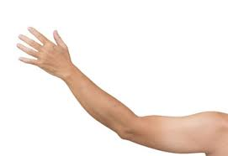
The Arm and Hand
finger, palm, wrist, forearm, elbow, upper arm, shoulder, thumb
The Hand and Fingers
See the photo of the parts of the hand below
hand
thumb
index finger
middle finger
ring finger
little finger (informal: pinky finger)
nail
knuckle

Slide 33
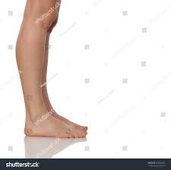
The Leg and Foot
knee, leg, shin, calf (muscle), ankle, heel, foot, toe
ankle - the joint between your leg and your foot.

Slide 34
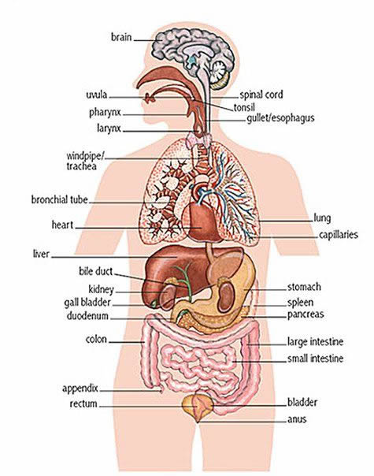
Internal Parts of the Body
heart - your heart pumps your blood around your body.
lungs - when you breathe, the air goes into your lungs.
veins - these transport blood through your body. They are like little tubes.
brain - this is your 'thinking machine' inside your head.
throat - food goes down this to get to your stomach.
liver - the organ that cleans your blood.
stomach - your food goes here when you swallow it.
kidneys - the organs that process all your body waste.
skeleton - all of the bones in your body.
ribs - these are the bones that protect the organs in your chest.
bones - your skeleton consists of many bones. There are about 206 in your body.
skin - it covers almost the entire body and helps keep all the organs and muscles in place.

Slide 35
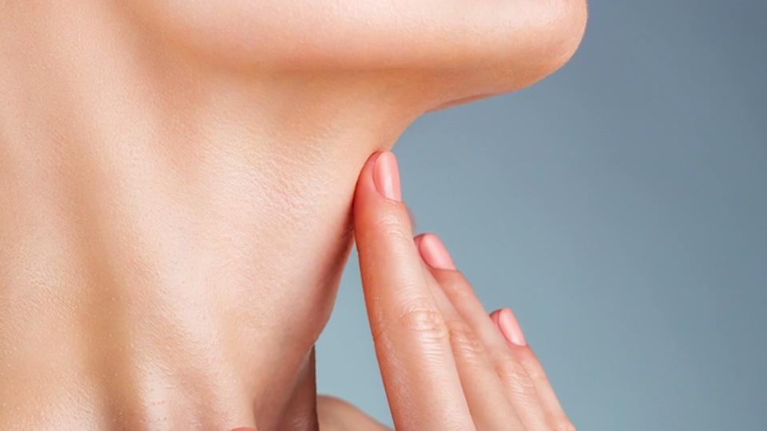
Other Parts of the Body
Here is a list of some other parts of the body that have not been included above. We will take some more photos of these when we find some more volunteers.
face - hair - tongue - tooth - back - waist - muscles
neck - this connects your head with your shoulders and the rest of your body.
tongue - the muscle at the bottom of your mouth that tastes things and helps you pronounce words
wrinkles - the lines in your skin caused by age. Old people have a lot of wrinkles.

