Slide 1
Second Meeting
Unit 1 Lesson 4
Can You Swim?

Slide 2
HOMEWORK
(From EC Summary page 11)
My mom can cook.
My dad can run fast.
My brother can ride a horse.
My sister can sing.

Slide 3
EXAMPLE
Hello, friends!
My name is Tom.
I can swim.
My mom can cook.
My dad can run fast.
My brother can ride a horse.
My sister can sing.
Who can cook?
____________________________________.
2. Who can run fast?
_____________________________________.
Who can ride a horse?
______________________________________.
Tom’s mom can cook.
His dad can run fast.
His brother can ride a horse.

Slide 4
Let’s sing a song!
Yes, I Can!
Can you sing? Can you dance? Can you play the guitar?
Can you draw? Can you juggle? Can you jump high?
Can you walk on your hands?
Yes, I can sing. I can dance. I can play the guitar.
I can draw. I can juggle. I can jump high.
I can walk on my hands.
Yes, I can!

Slide 5
SENTENCE PATTERN
Can you ____________ ?
(+ Verb 1)
Yes, I can.
No, I can’t.
No, I cannot.
can’t = cannot

Slide 6
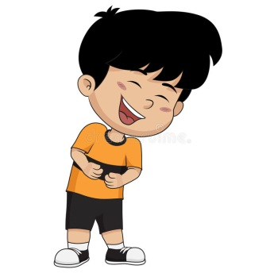
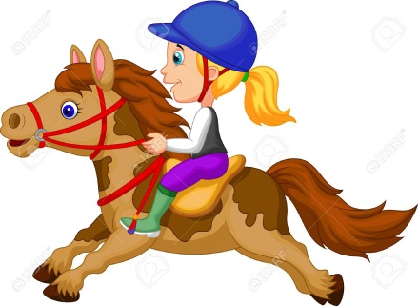
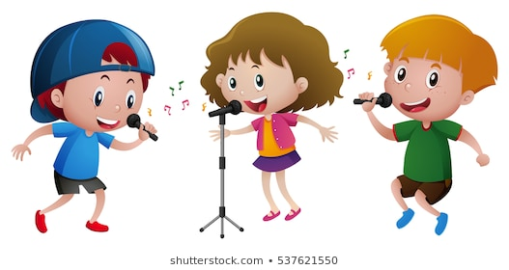
VERB
swim
laugh
ride a horse
sing
write
read

Slide 7
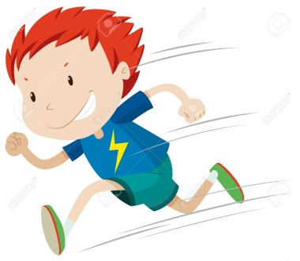
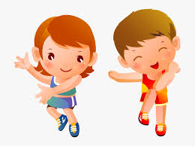
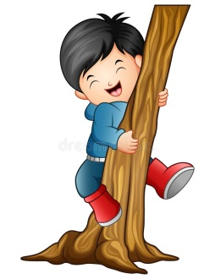
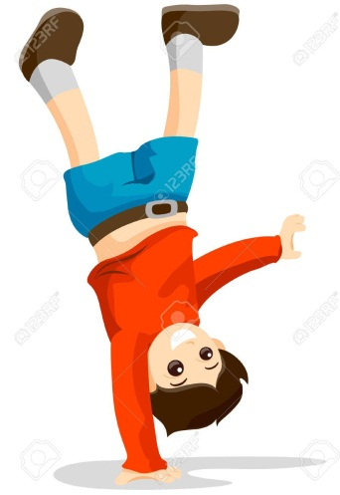
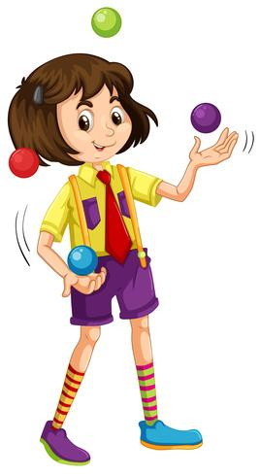
run fast
jump high
dance
climb
juggle
walk on one’s hand

Slide 8
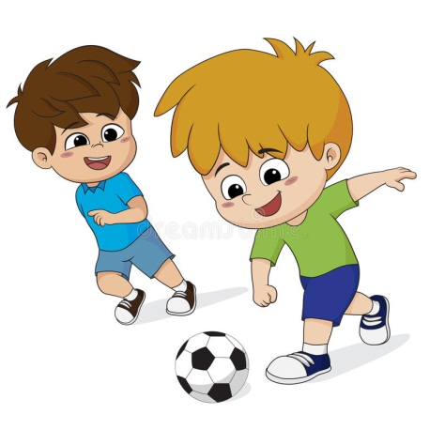
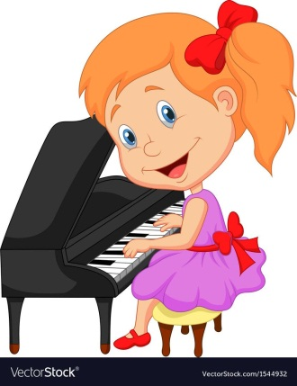
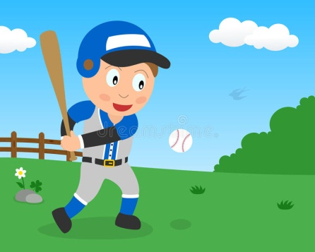
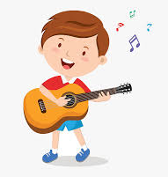
play basketball
play soccer
play the piano
play baseball
play the guitar

Slide 10
Can you juggle?
Yes, I can.

Slide 11
Can you walk on one’s hand?
No, I can’t.

Slide 12
Can they sing?
Yes, they can.

Slide 13
Can they play soccer?
No, they can’t.

Slide 14
Can he run fast?
No, he can’t.

Slide 15
Can she jump high?
Yes, she can.

Slide 16
laugh
A : Can you _________?
B : Yes, I ______.
can
you
A : Can _______ write?
B : No, _____ can’t.
I

Slide 17
Uncramble
1. can – jump – you - ? - high
Can you jump high?
2. play – They – baseball - . - can
They can play baseball.

Slide 18
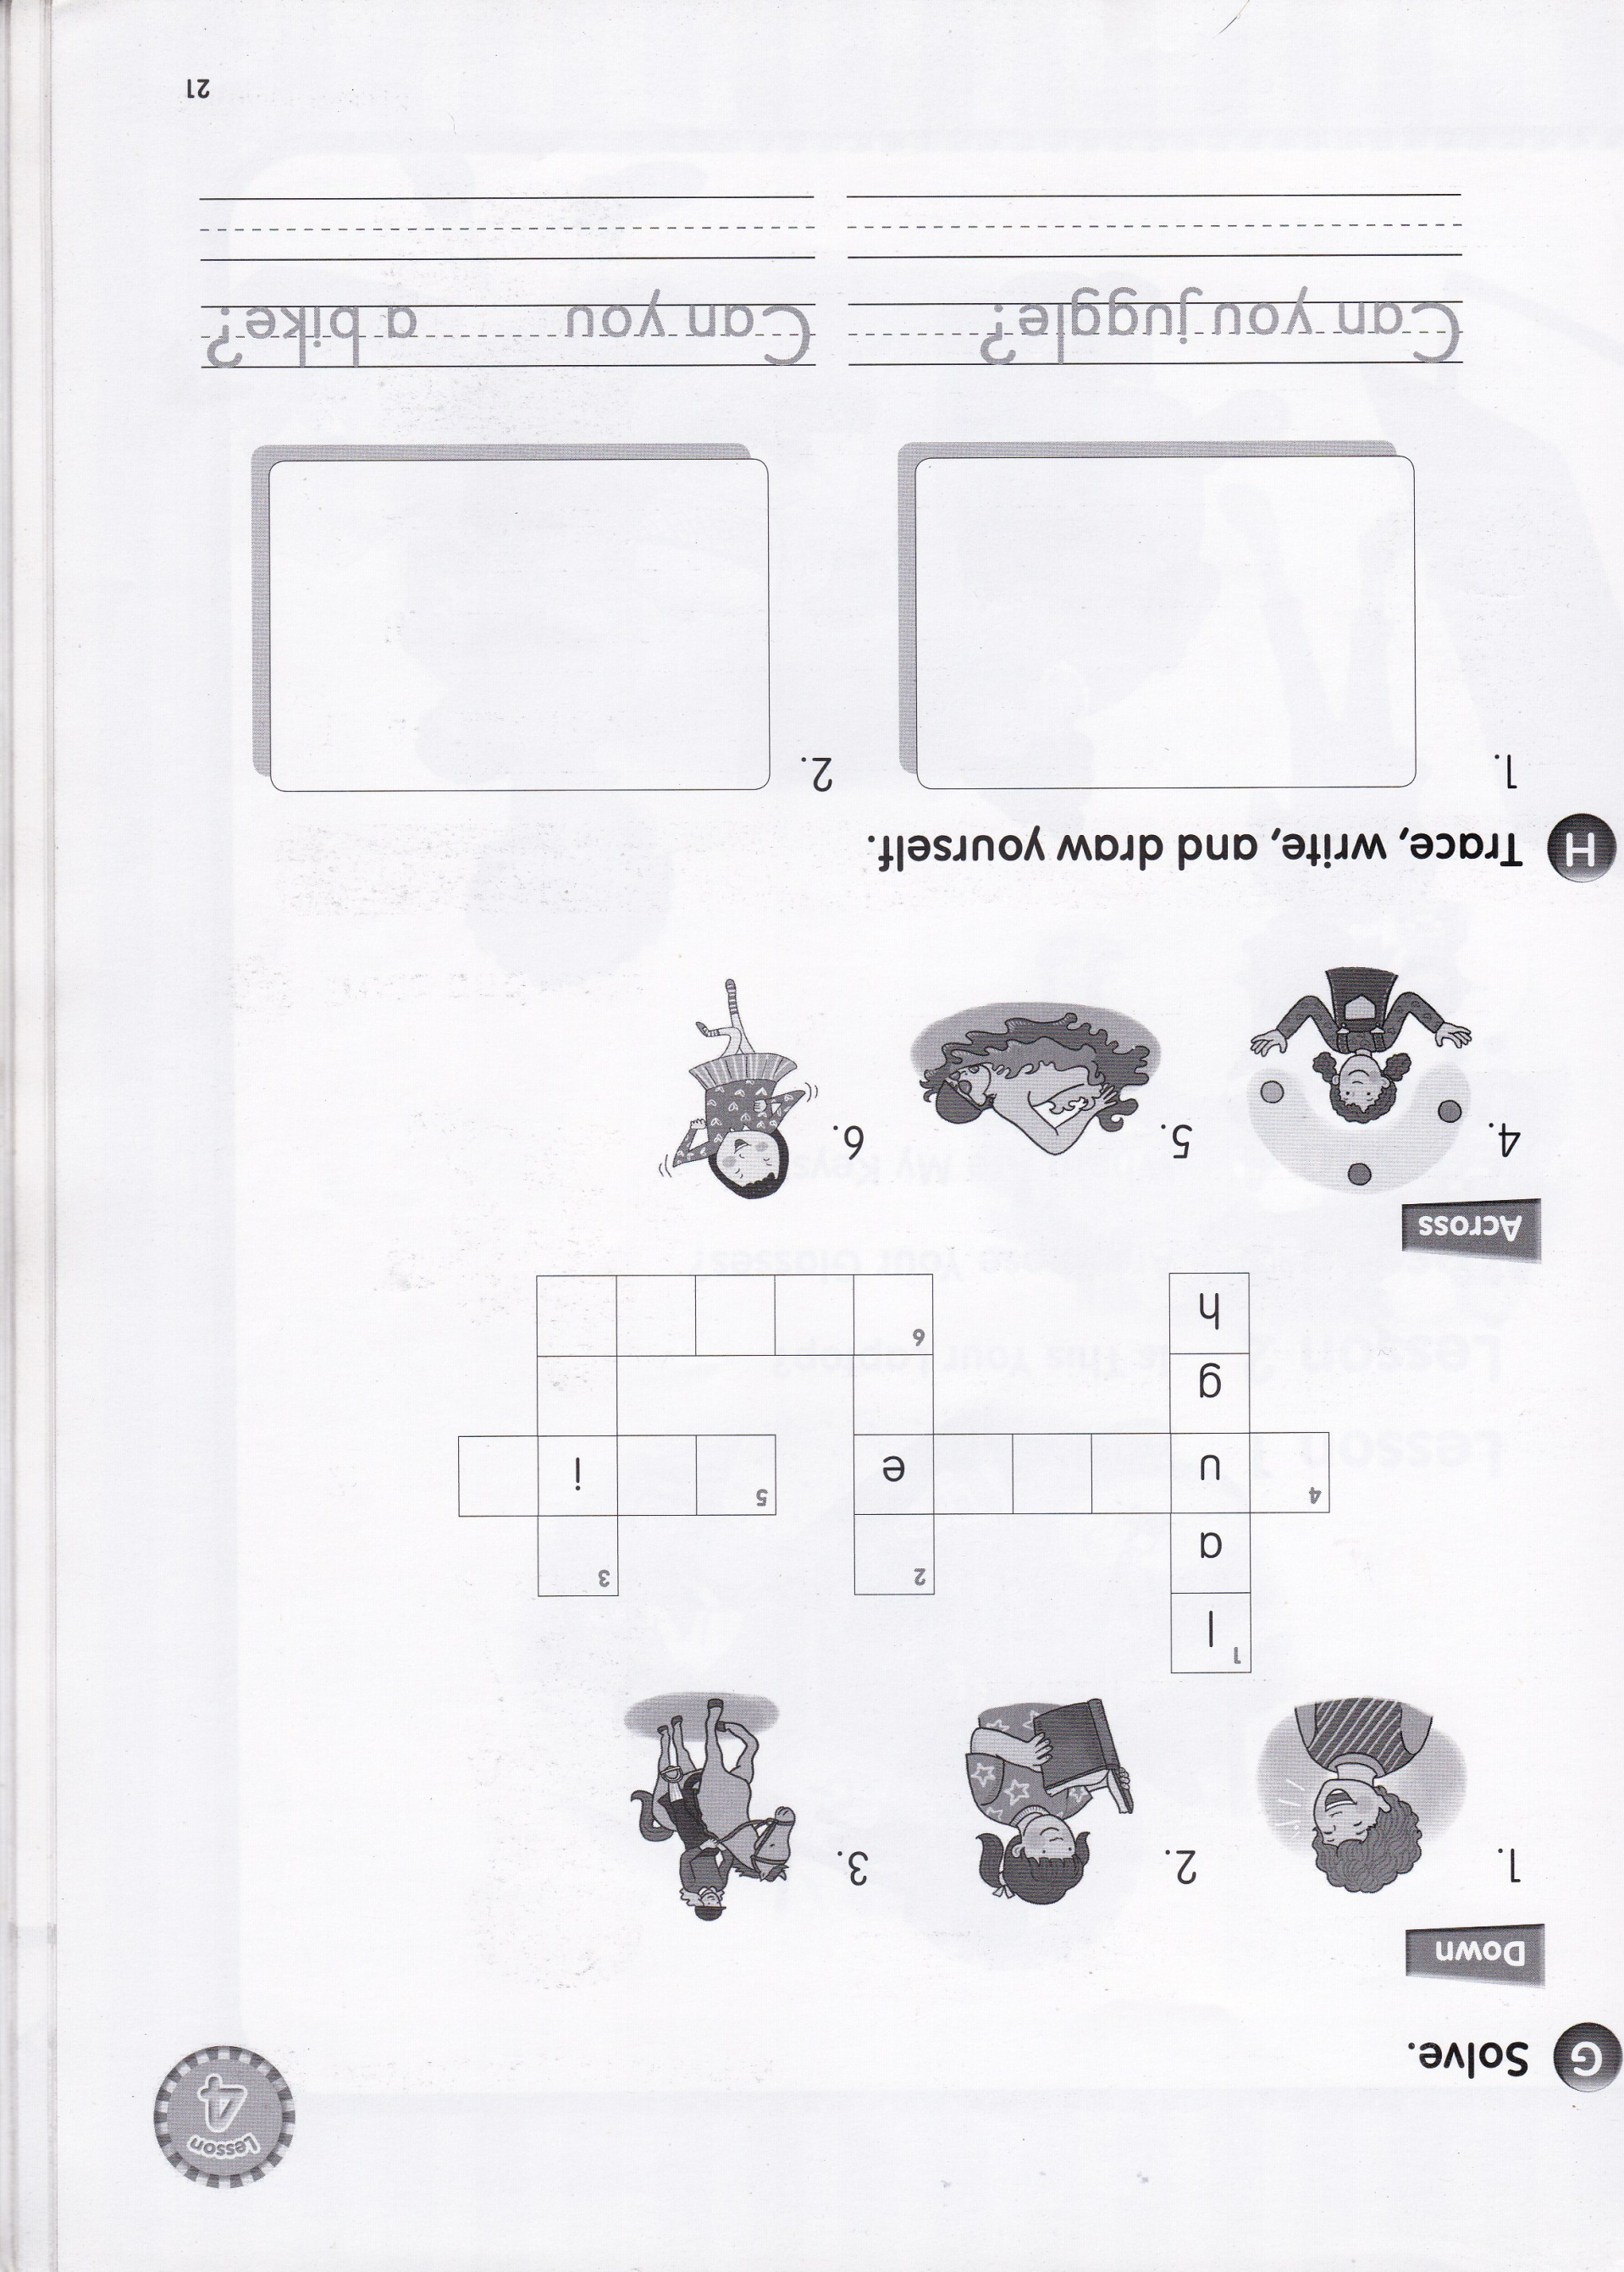
r
r
j
g
g
l
s
w
m
a
d
d
a
n
c
e

