Slide 1
Is This Your Laptop?
Unit 2 Lesson 2
Let’s go!

Slide 2
Possessive Adjectives
their
your
his
my
her
its
our

Slide 3
Possessive Adjectives (kata ganti kepemilikan)
Subject
Possessive Adjectives
I my
You your
We our
They their
He his
She her
It its

Slide 4
Possessive Adjectives (+ noun)
1. This is my laptop.
2. This is your glue.
3. This is our camera.
4. This is their computer.
5. This is his cell phone.
6. This is her pencil sharpener.
7. This is its ball.

Slide 5
Is this your ________ ?
Is that your ________ ?
Yes, it is. It’s mine.
No, it’s not. It’s my _____.
No, it’s not. It’s _____ (possessive).

Slide 6
What can you see?
I can see a laptop.

Slide 7
What is it?
It’s a stapler.

Slide 8
This is my stapler.

Slide 9
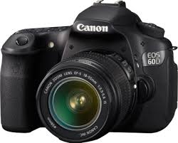
What is it?
It’s a camera.

Slide 10
Is this your camera?
Yes, it is. It’s mine.

Slide 11
What is it?
It’s a glue.

Slide 12
Is this his glue?
Yes, it is. It’s his glue.

Slide 13
What is it?
It is a stereo.

Slide 14
What is it?
It is a computer.

Slide 15
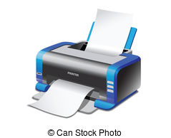
What is it?
It’s a printer.

Slide 16
What is it?
It’s a CD.

Slide 17
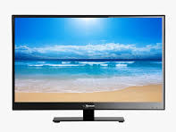
What is it?
It’s a TV.

Slide 18
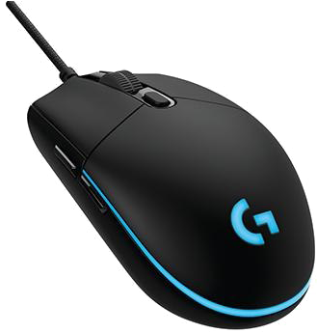
What is it?
It’s a mouse.

Slide 19
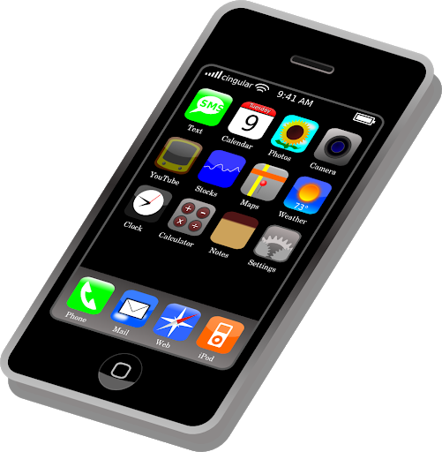
What is it?
It’s a cell phone.

Slide 20
What is it?
It’s a MP3 player.

Slide 21
3
5
2
4
1

Slide 24
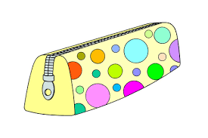
Dani : Is this your pencil case?
Lia : Yes, it is. It’s mine.

Slide 25
Andi : Is that your mouse?
Paul : No, it isn’t. It’s my brother’s.

Slide 26
MP3 player / Pam
A : Whose MP3 player is it?
B : It’s Pam’s.

Slide 27
computer / Bill
A : Whose computer is it?
B : It’s Bill’s.

Slide 28
Incorrect sentences
Correct sentences
This is I laptop.
1. This is my laptop.
2. This is you TV.
2. This is your TV.
3. This is he glue.
3. This is his glue.

Slide 29
Let’s sing a song!
Whose Ball Is It?
Whose ball is it? Whose ball is it?
It’s Tom’s. It’s Tom’s.
Whose book is it? Whose book is it?
It’s Anne’s. It’s Anne’s.
Whose ball is it? Whose book is it?
Whose ball is it? Whose book is it?
It’s Tom’s soccer ball, and it’s Anne’s red book.
.

