Slide 1
First Meeting
Unit 1 Lesson 4
What Are You Doing?

Slide 2
In this lesson you will learn about activities you are doing.

Slide 3
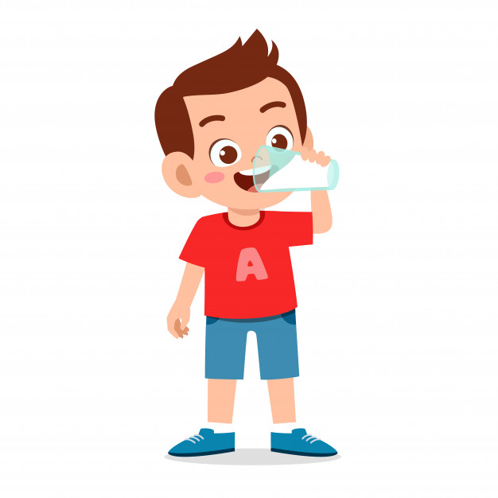
What is he doing?

Slide 4
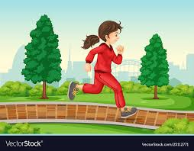
What is she doing?

Slide 5
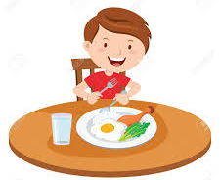
What is he doing?

Slide 6
Let’s sing a song!
What Are You Doing?
What, what are you doing?
I’m relaxing.
What, what are you doing?
I’m coloring a picture.
Walking to the music store!
Cleaning my bedroom!
Playing a game!
What are you doing?
Clap! Clap! Clap! Clap!
What are you doing?
What are you doing?
Clap! Clap! Clap! Clap!
What are you doing?

Slide 7
GRAMMAR FOCUS
Present Progressive
(Present Continuous Tense)
Kegiatan yang sedang dilakukan.

Slide 8
SENTENCE PATTERN
Subject
to be
Verb - ing
+
+

Slide 9
Subject
to be
I am
You are
We are
They are
He is
She is
It is

Slide 10
Verb + ing
play + ing = playing
do + ing = doing
eat + ing = eating
watch + ing = watching
drink + ing = drinking
run + ing = running

Slide 11
Verb + ing
walk + ing = ______________
clean + ing = ______________
hold + ing = _______________
color + ing = _______________
work + ing = _______________
surf + ing = _______________
fly + ing = _______________
wash + ing = _______________
paint + ing = _______________
talk + ing = _______________
sleep + ing = _______________
run + ing = ______________
shop + ing = ______________
sit + ing = ______________
swim + ing = ______________
walking
running
cleaning
shopping
holding
sitting
coloring
swimming
working
surfing
jogging
flying
washing
painting
talking
sleeping

Slide 12
Example
1. I am cleaning the whiteboard.
2. You are studying English.
3. We are playing soccer.
4. They are flying a kite.
5. He is eating doughnut.
6. He is cooking in the kitchen.

Slide 13
Ask and answer
Lisa : What are you doing?
Daniel : I ____________ (color) the picture.
am coloring
Jane : What is Karen doing?
Luis : Karen _____________ (swim).
is swimming
Juan : What is Peter doing?
Sara : He ______________ (watch) TV.
is watching

Slide 14
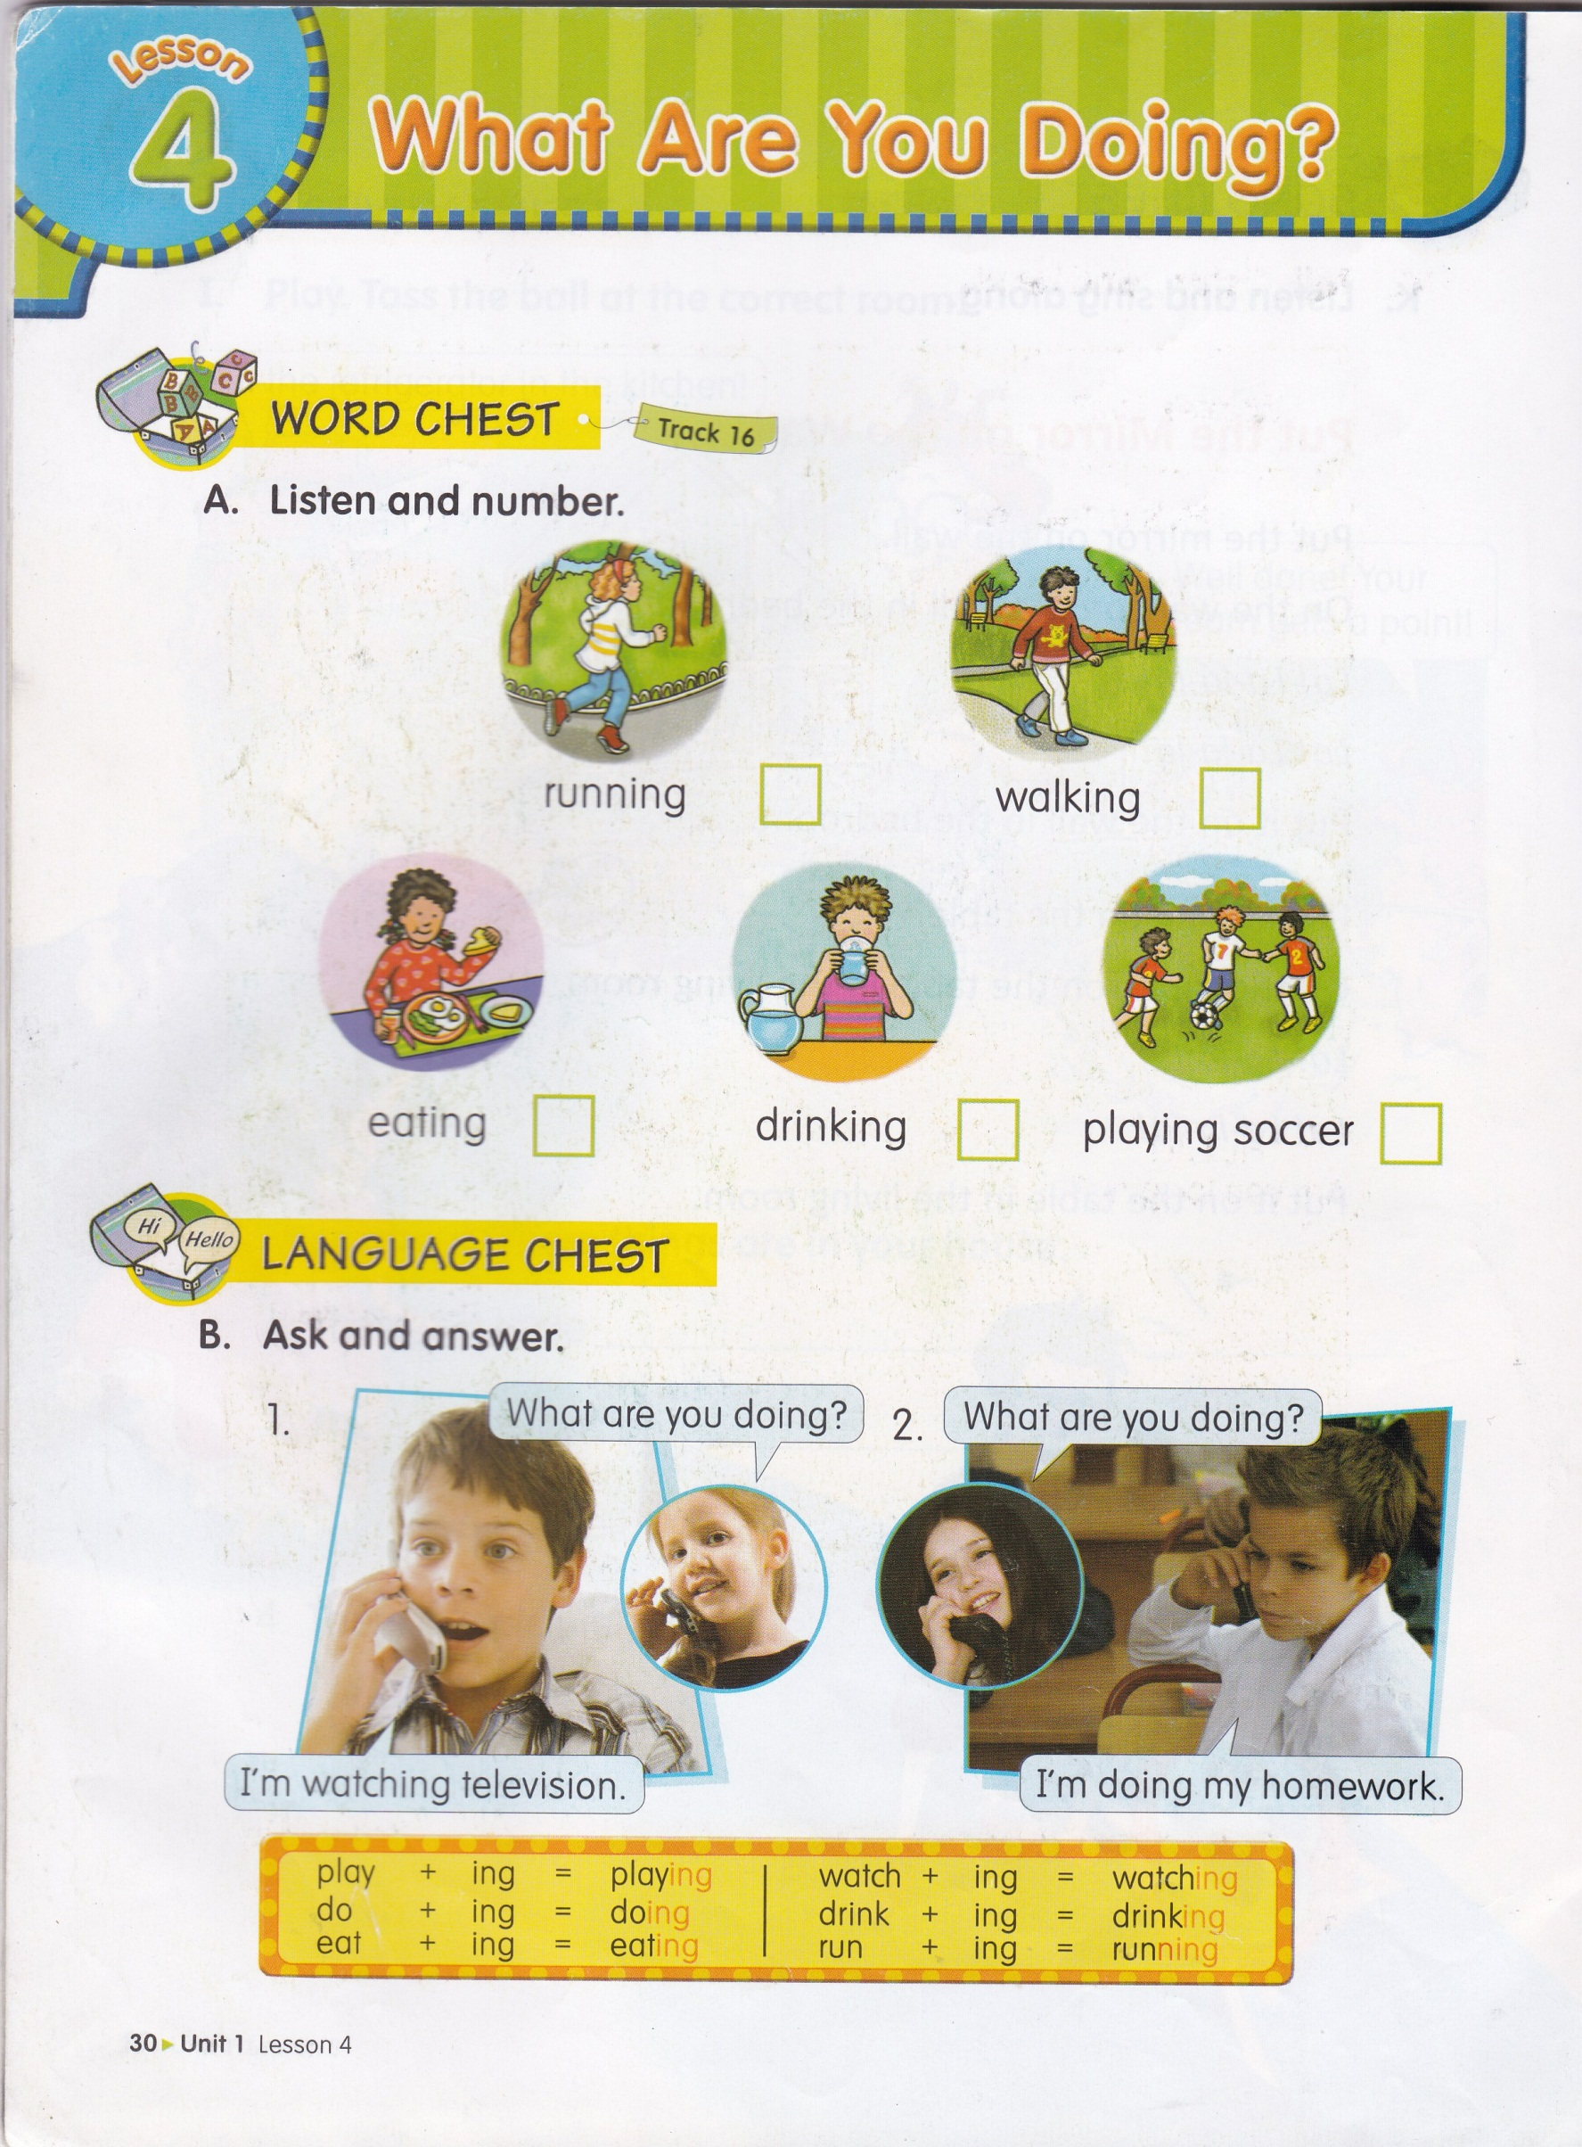
2
5
4
3
1

Slide 16
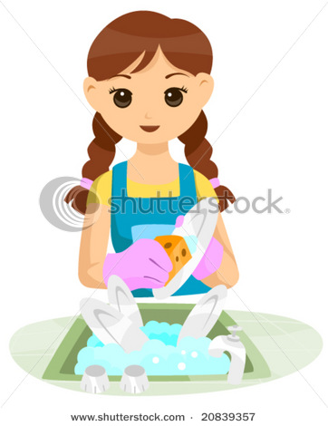
What is she doing?
She is washing the dishes.

Slide 17
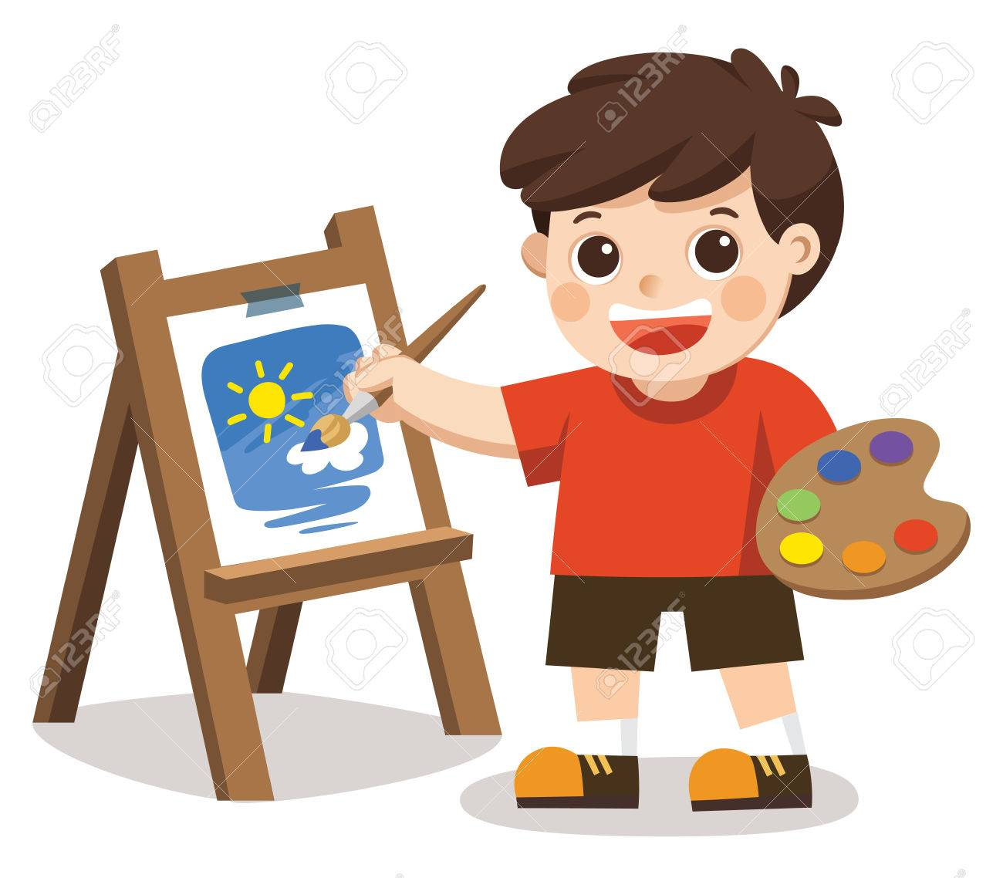
What is he doing?
He is painting the picture.

Slide 18
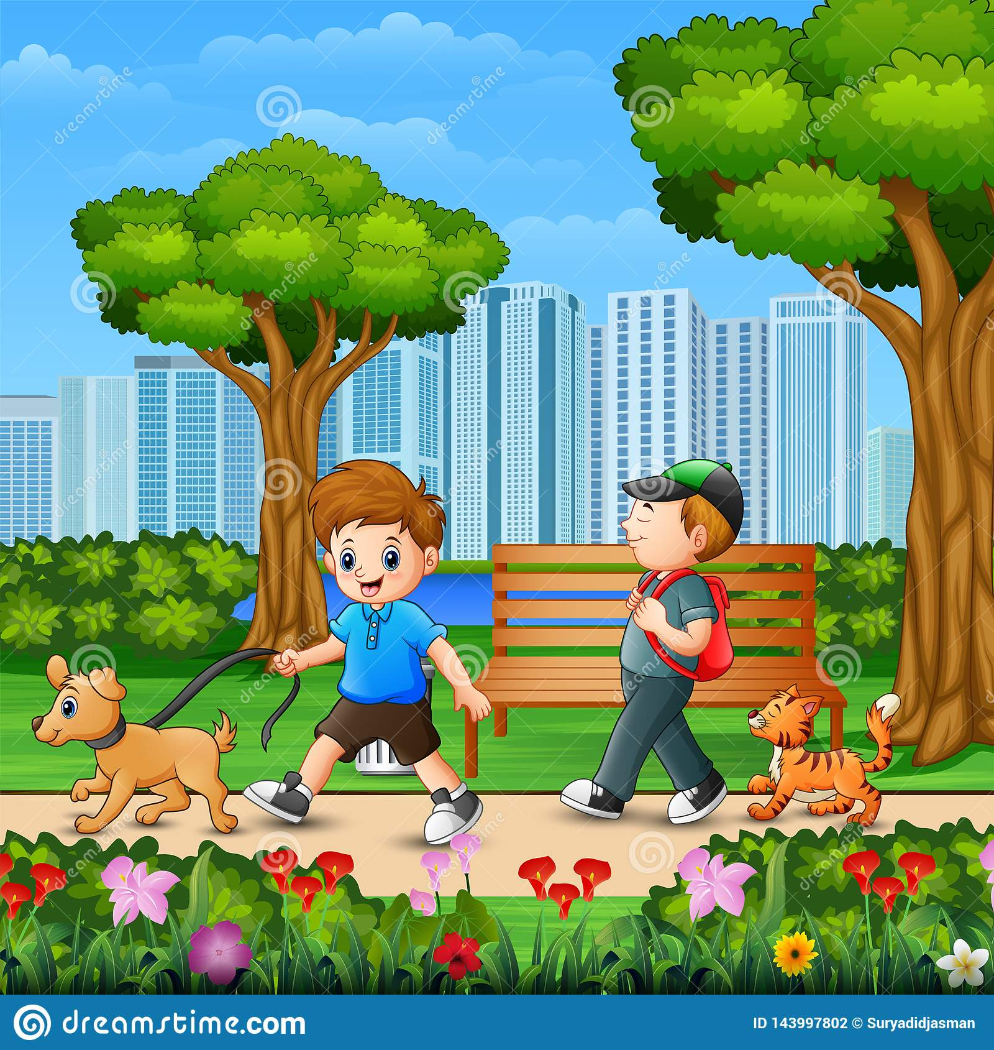
What are they doing?
They are walking.

Slide 19
Where are they walking?
They are walking in the garden.

Slide 20
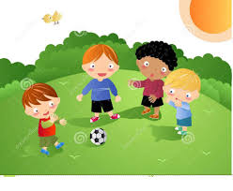
What are they doing?
They are playing soccer.

Slide 21
Where are they playing soccer?
They are playing soccer in the field.

Slide 22
HOMEWORK
(From EC Summary page 13)
is

Slide 23
HOMEWORK
(From EC Summary page 14)
doing

