Slide 1
Second Meeting
Unit 1 Lesson 4
What Are You Doing?

Slide 2
HOMEWORK
(From EC Summary page 13)
is
is
am
are
is
is
are
are

Slide 3
HOMEWORK
(From EC Summary page 14)
doing
she
book
not
watching
No
washing
dishes

Slide 4
GRAMMAR FOCUS
Present Progressive
(Present Continuous Tense)
Kegiatan yang sedang dilakukan.

Slide 5
SENTENCE PATTERN
Subject
to be
Verb-ing
+
+

Slide 6
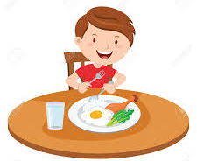
What are you doing?
I am relaxing.
I am eating.
I am flying a kite.
I am holding a present box.

Slide 7
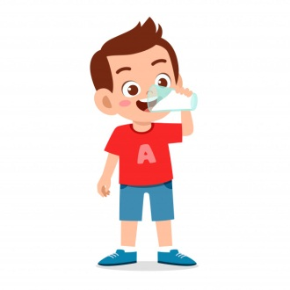
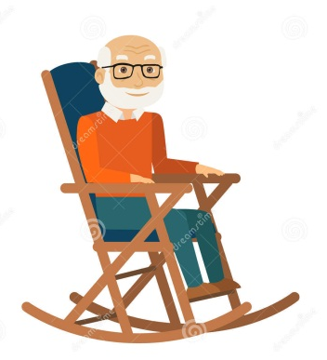
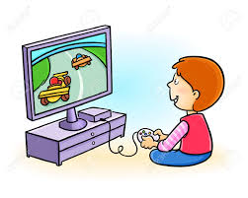
What is he doing?
He is running.
He is drinking.
He is sitting.
He is playing a computer game.

Slide 8
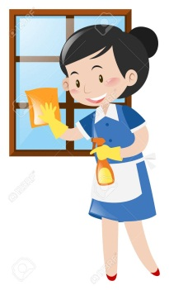
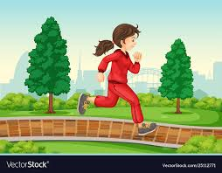
What is she doing?
She is cleaning the window.
She is running.
She is typing.
She is playing a doll.

Slide 9
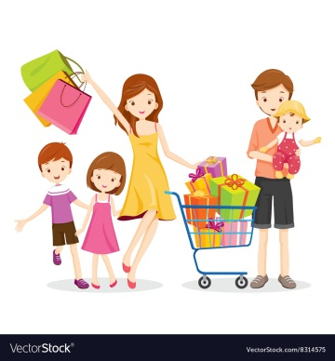
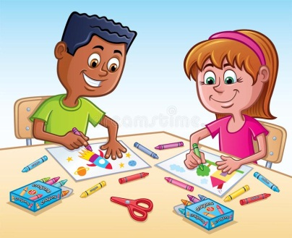
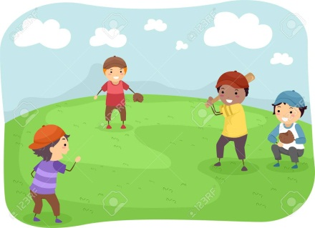
What are they doing?
They are shopping.
They are coloring the pictures.
They are doing sport.
They are playing baseball.

Slide 10
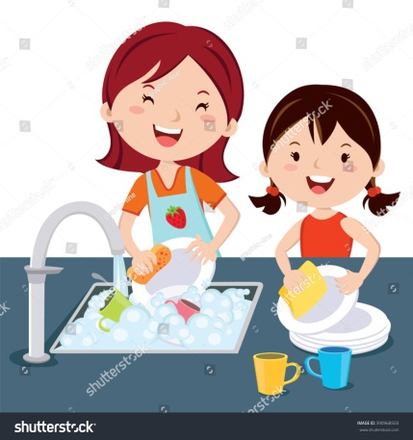
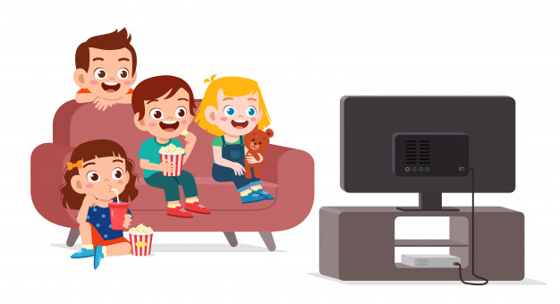
What are we doing?
We are surfing on waves.
We are studying.
We are washing the dishes.
We are watching television.

Slide 11
Let’s sing a song!
What Are You Doing?
What, what are you doing?
I’m relaxing.
What, what are you doing?
I’m coloring a picture.
Walking to the music store!
Cleaning my bedroom!
Playing a game!
What are you doing?
Clap! Clap! Clap! Clap!
What are you doing?
What are you doing?
Clap! Clap! Clap! Clap!
What are you doing?

Slide 12
What
are
I’m
you
What
are
you
doing
I’m

Slide 14
What is he doing?
2. What is his dad doing?
3. What do they love doing?
He is watching TV.
He is working.
They love playing computer games.

Slide 15
doing
doing
playing
cleaning
relaxing

Slide 16
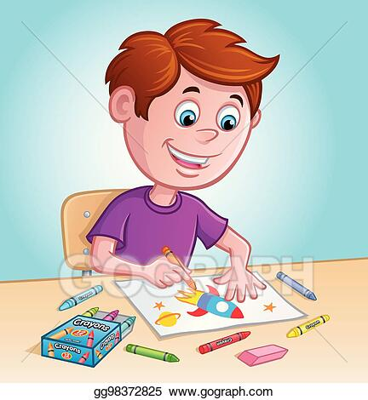
Complete the conversation!
A : _______ are ______ _______?
B : I’m __________ a picture.
A : Is it cute?
B : _________, it is. What_______ _______ ________?
A : I’m _________ my homework.
What
you
doing
coloring
Yes,
are
you
doing
doing

Slide 17
Rewrite the sentences with Verb –ing.
his Math test.
I am washing the dirty dishes.
She is holding her little brother.

Slide 18
Use the clues to write the conversation.
What is Dave doing?
He is playing computer games in the living room.
What is Alex doing?
He is cleaning the house with dad.

Slide 19
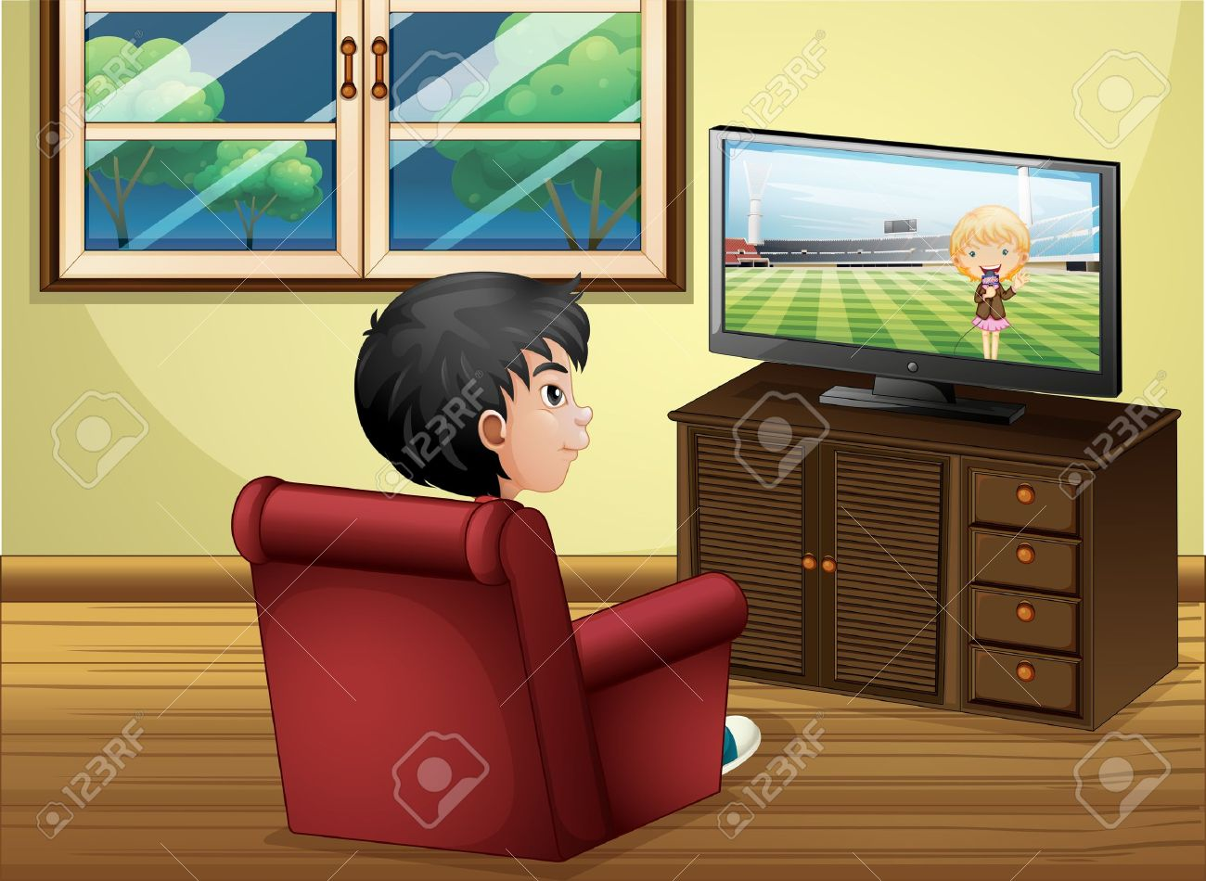
Where is Tom? What is he doing?
He is in the living room.
He is watching a movie.

Slide 20
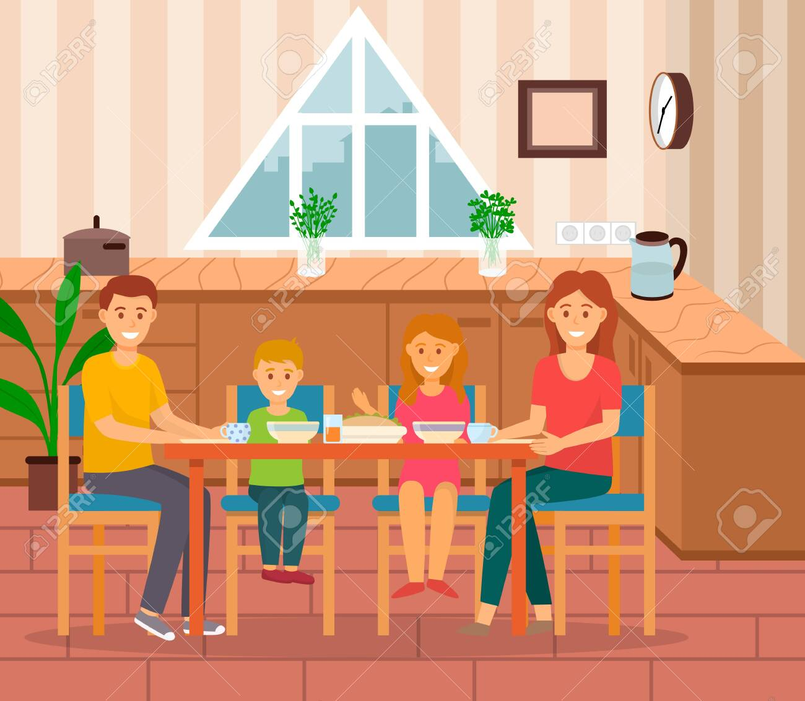
Where are they? What are they doing?
They are in the dining room.
They are having dinner.

Slide 21
Are you flying a kite?
Yes, I am.

Slide 22
Are you cleaning the window?
No, I am not.
I am eating lunch.

Slide 23
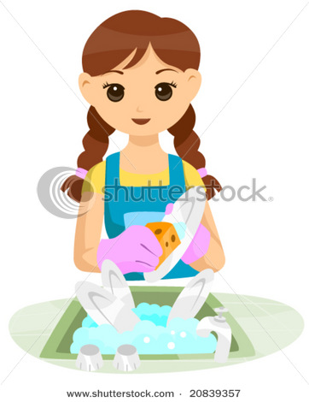
Is she drinking?
No, she isn’t.
She is washing the dishes.

Slide 24
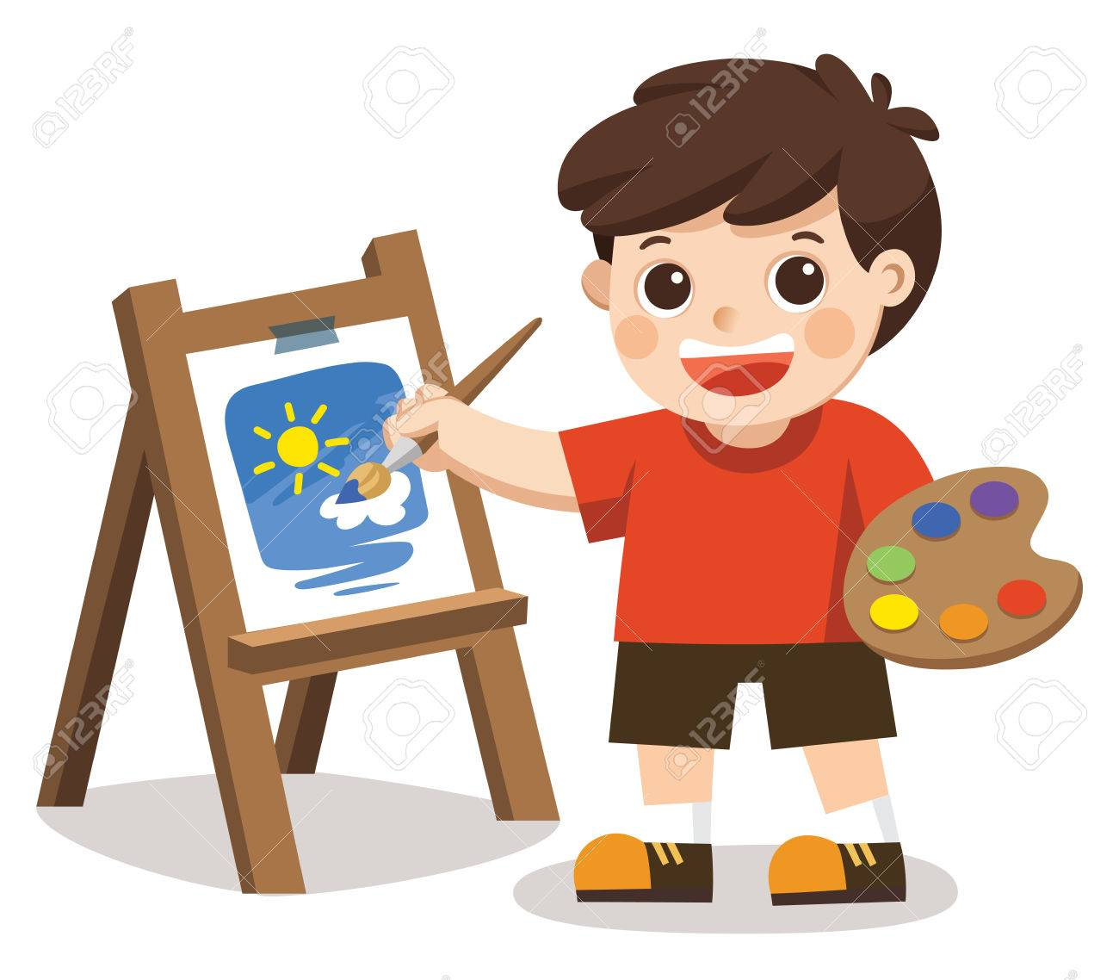
Is he painting the picture?
Yes, he is.

Slide 25
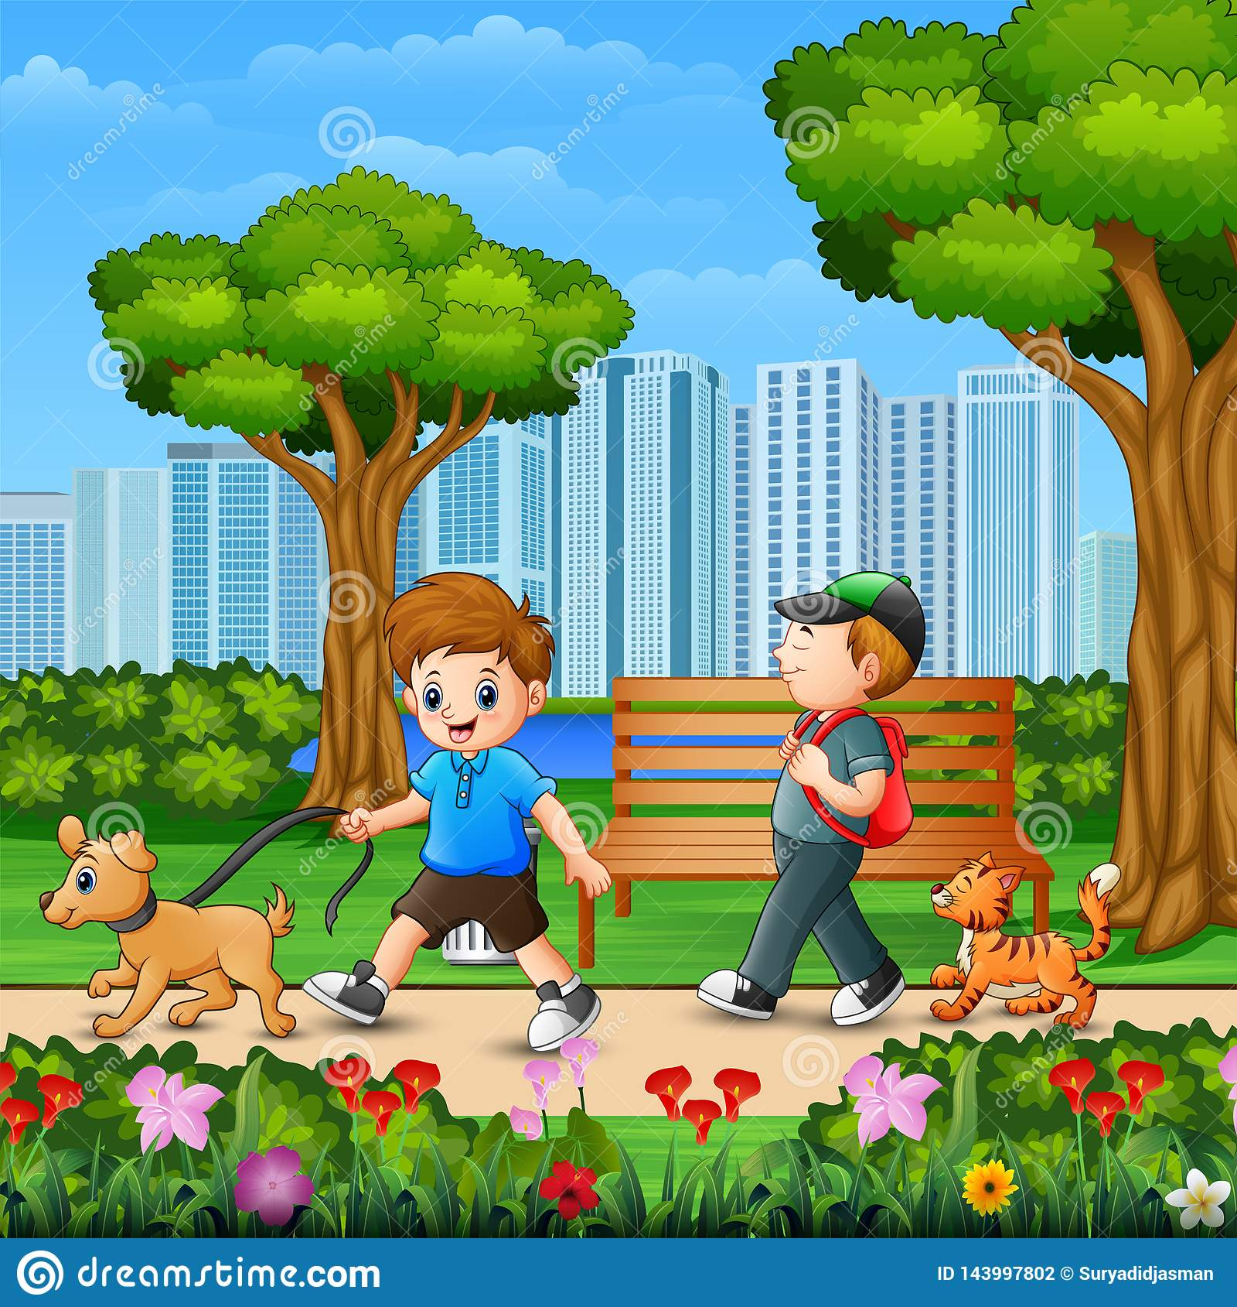
Are they sleeping?
No, they aren’t.
They are walking.

Slide 26
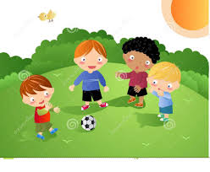
Are they playing soccer?
Yes, they are.

Slide 27
Are they playing soccer in the swimming pool?
No, they aren’t.
They are playing soccer in the yard.

