Slide 1
What Does
She Look Like?

Slide 2
HOMEWORK
I’m smart, diligent, handsome and faithfull.
She is
He is
He is
They are

Slide 3
In this lesson we are going to learn how to describe someone or something using
Adjectives.

Slide 4
Adjectives
GRAMMAR FOCUS
Blond, fat, thin, cute, etc.
Look like

Slide 5
What does he/she/it look like?
SENTENCE PATTERNS
He’s / She’s / It’s ______ and _______.
What do you/they/we/I look like?
What do you/they/we/I look like?
I’m/ you’re/ they’re/ we’re______ and _______.

Slide 6
Is she/ he/ it _______?
Yes, she/he/it is.
No, she/he/it isn’t. She/he/it is _____.
Are they_______?
Yes, they are.
No, they aren’t. They are _______.

Slide 7
do
does
he
I
you
she
we
it
they

Slide 10
look
like
look
like
and
It’s
and

Slide 13
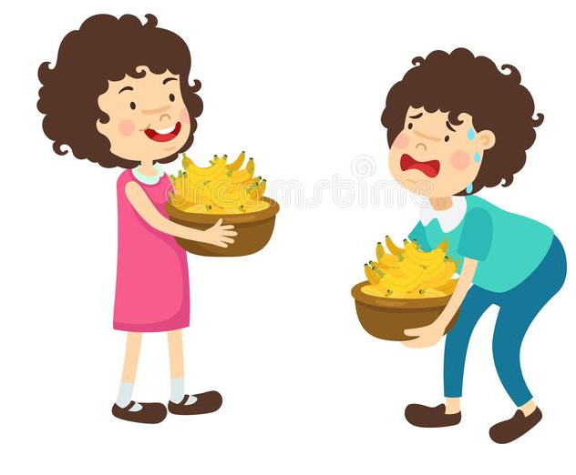
Yes, she/he/it is.
No, she isn’t. She is______.
Is she strong?
No, she isn’t. She is weak.

Slide 14
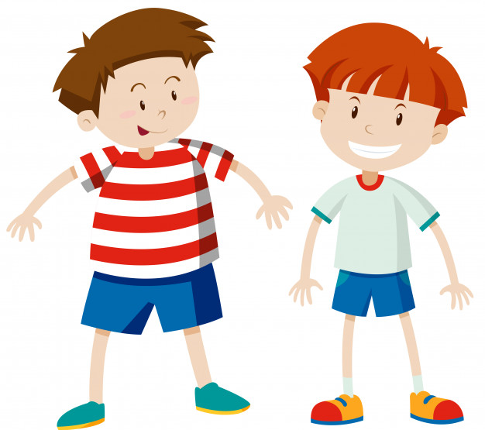
Yes, she/he/it is.
No, she isn’t. She is______.
Is he fat?
Yes, he is.

Slide 15
Yes, they are.
Yes, they are.
No, they aren’t. They are______.
No, they aren’t. They are______.
Are they ugly?
Yes, they are.

Slide 16
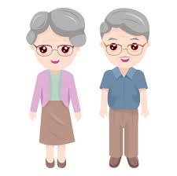
Yes, they are.
Yes, they are.
No, they aren’t. They are______.
No, they aren’t. They are______.
Are they young?
No, they aren’t. They’re old.

Slide 17
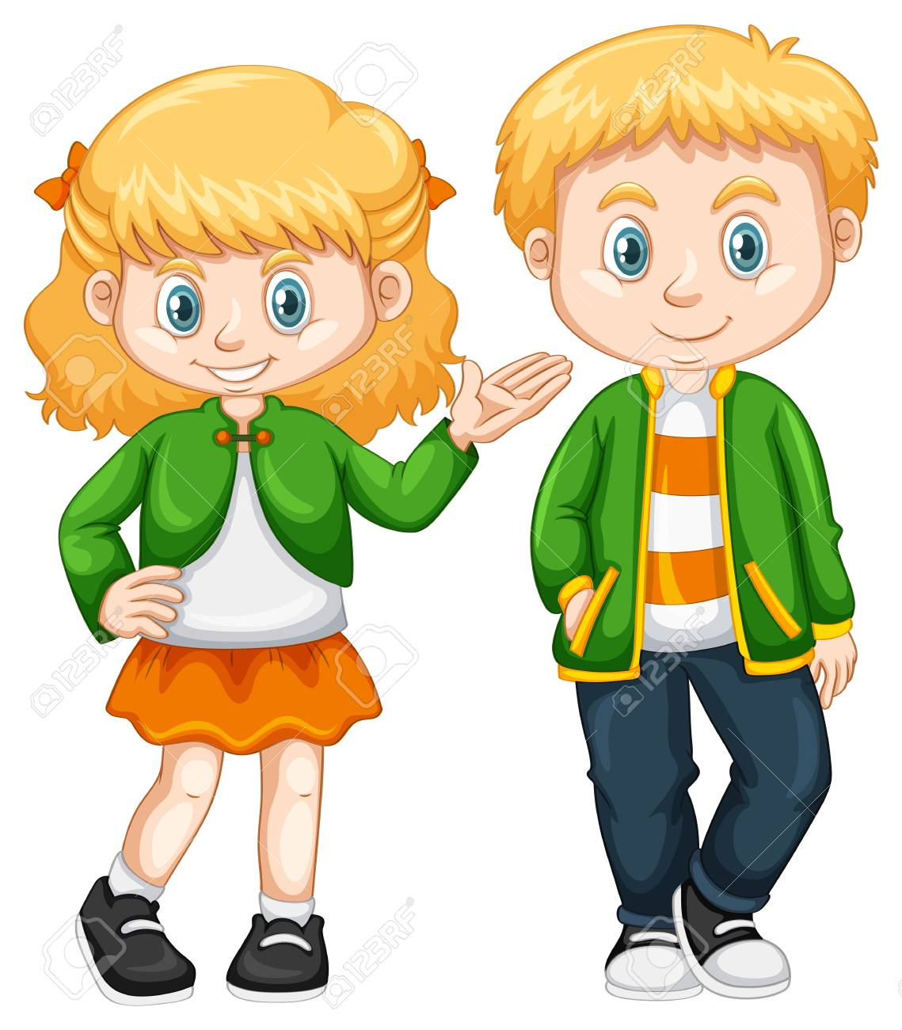
Yes, they are.
No, they aren’t. They are______.
What do they look like?
They’re cute. They have blond hair.

Slide 18
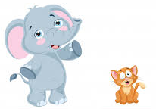
What does the elephant look like?
It’s big and strong.

Slide 19
I can’t find my dad.
What does he look like?
He is big and strong.
Is he blond?
No, he has red hair.
Look! I think I see him.
Yes, that’s him. Thank you!

Slide 20
old
big
thin
young
small
cute

Slide 21
Find the mistakes and rewrite the sentence.

Slide 22
She is short and pretty.

Slide 23
He is young and cute.

Slide 24
old
big
It’s fat and young.
blond and cute.

Slide 25
Let’s sing a song!
Short and Cute
Short and cute, short and cute!
What does your mother look like?
Short and cute, short and cute!
My mother is short and cute.
Big and strong, big and strong!
What does your father look like?
Big and strong, big and strong!
My father is big and strong.
Tall and thin, tall and tin!
What does your brother look like?
Tall and thin, tall and thin!
My brother is tall and tin.

Slide 26
Short and Cute
Short and cute, ___________ and ___________!
What does your _________ look like?
______ and ________, short and cute!
My mother is ________ and __________.
short
cute
mother
Short
cute
short
cute

