Slide 1
Unit 2 Lesson 1
What Were You Doing at Eight O’clock?

Slide 2
GENERIC OPENING SLIDES
Talking About Two Things Happening At The Same Time In The Past.
Past Progressive Tense,
when/ while clauses

Slide 3
Pretest
What were you doing when your mom cooked this morning?
What were you doing at seven o’clock this morning?

Slide 4
6
5
2
4
1
3

Slide 5
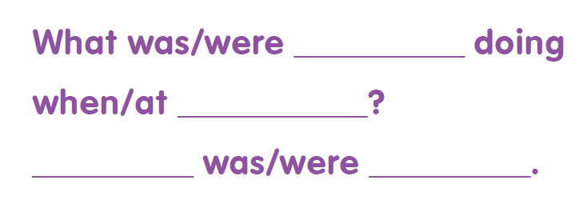
Sentence pattern

Slide 6
Past Progressive tense
Subject
Be
Verb – ing
Study- studying
Watch – watching
Go – going
Play - playing
Were
Was
You
We
They
I
She
He
It

Slide 8
What
were
doing
was

Slide 9
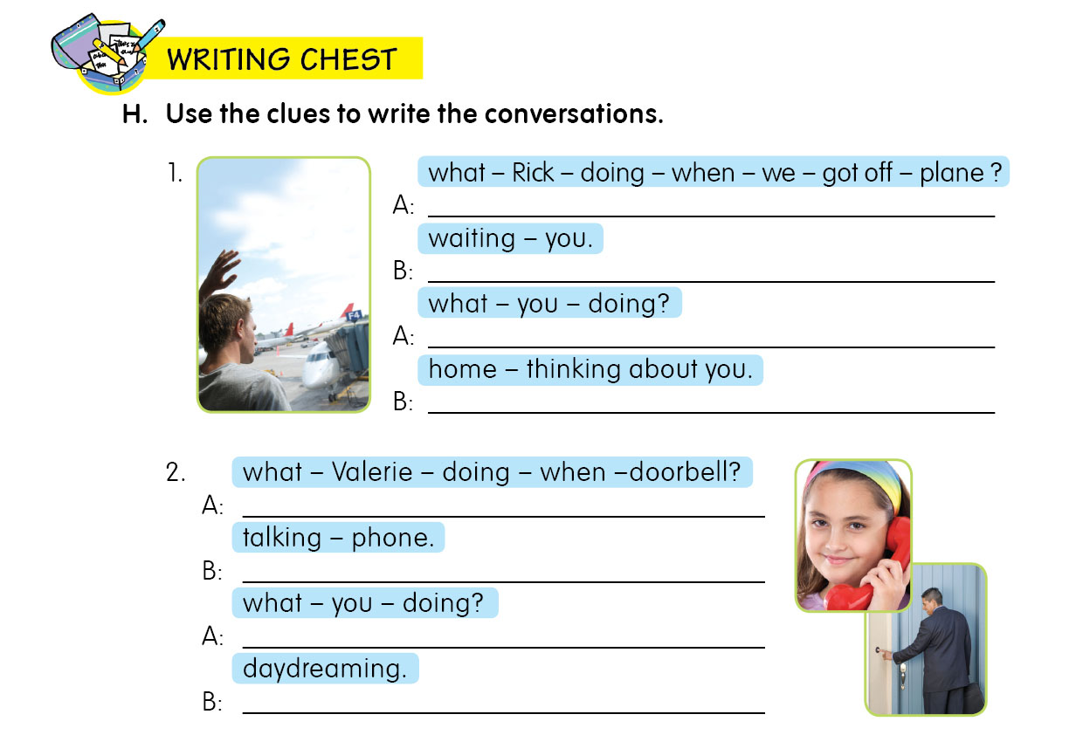
What was Rick doing when we got off the plane?
He was waiting for you.
What were you doing?
I was at home thinking about you.
What was Valerie doing when the doorbell rang?
She was talking on the phine.
What were you doing?
I was daydreaming.

Slide 10
AWW...
Thanks .. ☺

