Slide 1
SIMPLE PAST TENSE

Slide 3
To talk about actions
or
situations
that happened and finished
in the past.

Slide 4
S
V2
O

Slide 6
-ed/-d
WALK
-
WALKED
PLAY
-
PLAYED
STAY
-
STAYED
COOK
-
COOKED
DESCRIBE
-
DESCRIBED
COMPLETE
-
COMPLETED

Slide 8
Verb 2
SING
-
SANG
RUN
-
RAN
DRINK
-
DRANK
EAT
-
ATE
WRITE
-
WROTE
SEE
-
SAW

Slide 9
She joined english club yesterday
Abdul went to Bali for holiday, last Sunday
It was very sunny last Monday.

Slide 10
S
DID NOT
(DIDN’T)
V1

Slide 11
He did not eat this snack
I did not play soccer, yesterday
We did not study last night.
.

Slide 12
DID
S
V1

Slide 13
Did she eat her meal ?
Did you read some book ?
Did they play soccer ?
.

Slide 14
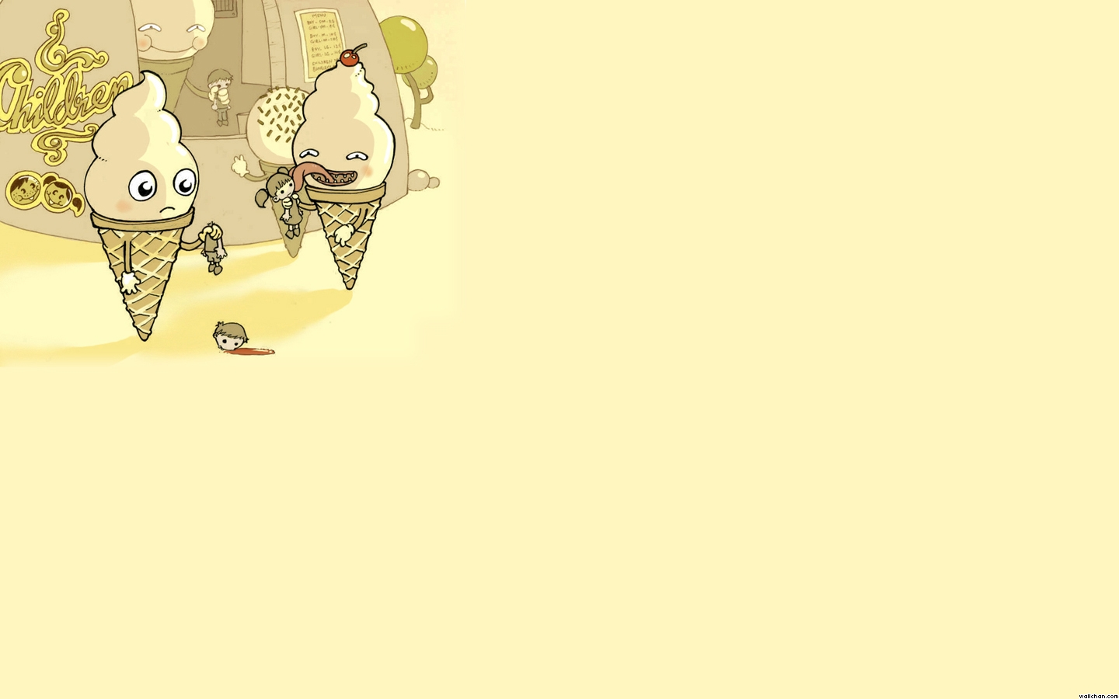
EXERCISE
Last year, I (go) to England on holiday
It (be) fantastic
I (visit) a lot of interesting places. I (be) with two friends of mine.

Slide 15
EXERCISE
Last year, I WENT to England on holiday
It (be) fantastic
I (visit) a lot of interesting places. I (be) with two friends of mine.

Slide 16
EXERCISE
Last year, I WENT to England on holiday
It WAS fantastic
I (visit) a lot of interesting places. I (be) with two friends of mine.

Slide 17
EXERCISE
Last year, I WENT to England on holiday
It WAS fantastic
I VISITED a lot of interesting places. I (be) with two friends of mine.

Slide 18
EXERCISE
Last year, I WENT to England on holiday
It WAS fantastic
I VISITED a lot of interesting places. I WAS with two friends of mine.

Slide 19
EXERCISE
In the morning, we (walk) in the streets of London.
In the evening, we (join) swimming club.
The weather (was) strangely fine.

Slide 20
EXERCISE
In the morning, we WALKED in the streets of London.
In the evening, we (join) swimming club.
The weather (be) strangely fine.

Slide 21
EXERCISE
In the morning, we WALKED in the streets of London.
In the evening, we JOINED swimming club.
The weather (be) strangely fine.

Slide 22
EXERCISE
In the morning, we WALKED in the streets of London.
In the evening, we JOINED swimming club.
The weather WAS strangely fine.

